Slide 1
Processing

Slide 2
Agenda
EMR
EMR Architecture
EMR Operations
Using Hue with EMR
Hive on EMR
HBase on EMR
Presto on EMR
Spark on EMR
EMR File Storage and Compression
Lambda in the AWS Big Data Ecosystem
HCatalog
Glue

Slide 3
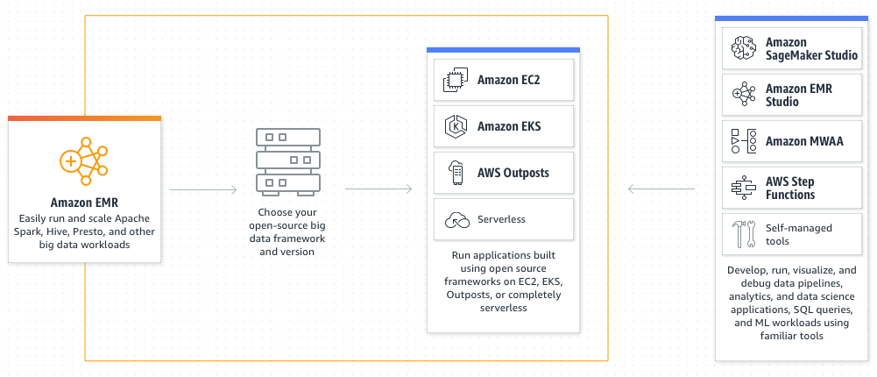
Amazon EMR
Amazon EMR is a cloud big data platform that uses open-source analytics frameworks like Apache Spark, Apache Hive, and Presto to conduct large-scale distributed data processing jobs, interactive SQL queries, and machine learning (ML) applications.
Users can process data for analytics and business intelligence tasks using these frameworks and related open-source projects.
Amazon EMR also allows users to transform and move massive amounts of data into and out of other AWS data stores and databases, such as Amazon S3 and Amazon DynamoDB.
Credit: https://aws.amazon.com/emr/
Notes:
Reference for contents :
https://docs.aws.amazon.com/emr/latest/ManagementGuide/emr-what-is-emr.html
https://aws.amazon.com/emr/

Slide 4
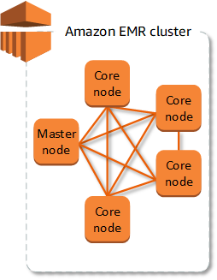
Understanding clusters and nodes in EMR
Master node runs software components to organize the allocation of data and tasks among other nodes for processing, and thereby administers the cluster. It also keeps track of task progress and oversees the cluster's health.
Core node conduct jobs and stores data in the Hadoop Distributed File System (HDFS) on the Hadoop cluster. At least one core node exists in multi-node clusters.
Task node has only software components and does not store data in HDFS. Task nodes are not required.
Credit: https://docs.aws.amazon.com/emr/latest/ManagementGuide/emr-overview.html
Notes:
Reference for contents :
https://docs.aws.amazon.com/emr/latest/ManagementGuide/emr-overview.html
More explanation:
The cluster is the most important part of Amazon EMR. An Amazon Elastic Compute Cloud (Amazon EC2) cluster is a collection of Amazon Elastic Compute Cloud (Amazon EC2) instances. A node is the name given to each instance in the cluster. The node type refers to the role that each node plays inside the cluster. In addition, Amazon EMR installs distinct software components on each node type, assigning each node a role in a distributed application such as Apache Hadoop.
Master node is present in every cluster, and it is feasible to establish a single-node cluster using only the master node

Slide 5
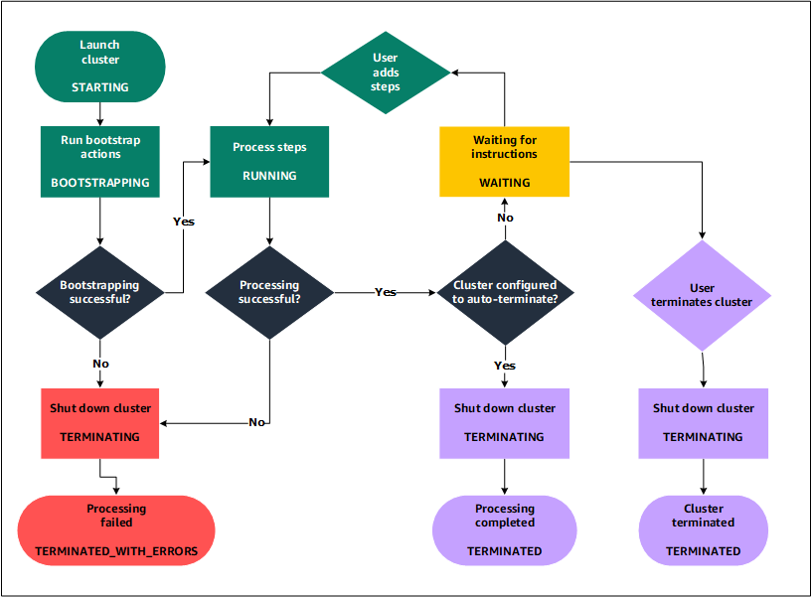
Understanding the cluster lifecycle
For each instance, Amazon EMR initially creates EC2 instances in the cluster according to the user's requests.
On each instance, Amazon EMR performs the bootstrap operations that users request. Bootstrap actions can be used by users to install custom applications and perform adjustments.
The native apps that users pick when they construct the cluster, such as Hive, Hadoop, Spark, and others, are installed by Amazon EMR..
The cluster status is RUNNING once all bootstrap procedures have been completed successfully and native apps have been installed.
The cluster enters a WAITING state when all stages have completed successfully.
Credit: https://docs.aws.amazon.com/emr/latest/ManagementGuide/emr-overview.html#emr-overview-data-processing
Notes:
Reference for contents :
https://docs.aws.amazon.com/emr/latest/ManagementGuide/emr-overview.html#emr-overview-data-processing
More explanation:
The cluster status is RUNNING once all bootstrap procedures have been completed successfully and native apps have been installed. Users can now connect to cluster instances, and the cluster will run any steps that the user requested when the cluster was formed sequentially. Additional steps can be submitted by users, and they will be executed once any earlier steps have been completed.
When a cluster is set to auto-terminate after the last step, it enters the TERMINATING state before entering the TERMINATED state. If the cluster is set to wait, the user will have to manually turn it off when done with it. The cluster enters the TERMINATING state once user manually shuts it down, and then the TERMINATED state.
Unless the user specifies termination protection, a failure during the cluster lifetime causes Amazon EMR to kill the cluster and all of its instances. If a cluster fails, all data on it is erased, and the cluster status is set to TERMINATED WITH ERRORS. If termination protection is enabled, the user can extract data from the cluster before removing termination protection and terminating the cluster.

Slide 6
EMR Architecture
Storage
Hadoop Distributed File System (HDFS)
EMR File System (EMRFS)
Local file system
Cluster resource management
Data processing frameworks
Hadoop MapReduce
Apache Spark
Applications and programs
Notes:
Reference for contents :
https://docs.aws.amazon.com/emr/latest/ManagementGuide/emr-overview-arch.html
More explanation:
Storage
HDFS (Hadoop Distributed File System) is a scalable, distributed file system for Hadoop. HDFS distributes data across cluster instances, storing several copies of data on separate instances to guarantee that no data is lost if a single instance dies. When user ends a cluster, HDFS is ephemeral storage that gets reclaimed. HDFS can be used to cache intermediate results during MapReduce processing or for workloads with a lot of random I/O.
Amazon EMR enhances Hadoop with the EMR File System (EMRFS), which allows users to easily access data stored in Amazon S3 as if it were a file system like HDFS. In your cluster, you can utilize either HDFS or Amazon S3 as the file system. In most cases, Amazon S3 is utilized to store input and output data, whereas HDFS is used to store intermediate results.
A locally linked disc is referred to as a local file system. Each node in a Hadoop cluster is built using an Amazon EC2 instance with a predefined block of pre-attached disc storage known as an instance store. Data on instance store volumes is only retained for the duration of the Amazon EC2 instance's lifecycle.
Cluster resource management
YARN (Yet Another Resource Negotiator), a component introduced in Apache Hadoop 2.0 to centrally manage cluster resources for diverse data-processing frameworks, is used by default in Amazon EMR. Other frameworks and applications available in Amazon EMR, on the other hand, do not employ YARN as a resource manager. In addition, each node contains an Amazon EMR agent that manages YARN components, maintains the cluster healthy, and communicates with Amazon EMR.
Data processing frameworks
The engine that processes and analyses data is the data processing framework layer. There are numerous frameworks that use YARN or have their own resource management system. Batch, interactive, in-memory, streaming, and other frameworks are available for different types of processing needs. The framework you use is determined on your use case. The languages and interfaces available from the application layer, which is the layer used to deal with the data you want to process, are affected by this. Hadoop MapReduce and Spark are the two main processing frameworks available for Amazon EMR.
Hadoop MapReduce is an open-source distributed computing programming model. It makes creating parallel distributed applications easier by taking care of all of the logic while you focus on the Map and Reduce functions. The Map function converts data into intermediate results, which are sets of key-value pairs. Reduce integrates intermediate findings, applies additional algorithms, and generates the final output. There are a variety of MapReduce frameworks available, including Hive, which builds Map and Reduce applications automatically.
Spark is a programming model and cluster architecture for addressing big data workloads. Spark is an open-source distributed processing system that, like Hadoop MapReduce, uses directed acyclic graphs for execution plans and in-memory caching for datasets. You can use EMRFS to directly access your data in Amazon S3 when you run Spark on Amazon EMR. Spark has a number of interactive query modules, including SparkSQL.
Applications and programs
Many applications, including as Hive, Pig, and the Spark Streaming library, are supported by Amazon EMR, allowing users to design processing workloads using higher-level languages, leverage machine learning methods, create stream processing applications, and build data warehouses. In addition, instead of using YARN, Amazon EMR enables open-source applications that have their own cluster management capability.

Slide 7

EMR operations
Processing data
A request is submitted to begin processing and all steps are set to PENDING.
When the first step in the sequence starts, its state changes to RUNNING. The other steps remain in the PENDING state.
After the first step completes, its state changes to COMPLETED.
The next step in the sequence starts, and its state changes to RUNNING. When it completes, its state changes to COMPLETED.
This pattern repeats for each step until they all complete and processing ends.
Credit: https://docs.aws.amazon.com/emr/latest/ManagementGuide/emr-overview.html#emr-overview-data-processing
Notes:
Reference for contents :
https://docs.aws.amazon.com/emr/latest/ManagementGuide/emr-overview.html#emr-overview-data-processing
More explanation:
The above diagram represents the step sequence and change of state for the steps as they are processed.
A step's status changes to FAILED if it fails during processing. For each phase, you can choose what occurs next. If a preceding step fails, any remaining stages in the sequence are set to CANCELLED and do not run. You can opt to overlook the failure and continue with the following procedures, or you can terminate the cluster right away.

Slide 8

EMR operations
A step's status changes to FAILED if it fails during processing. For each phase, you can choose what occurs next. If a preceding step fails, any remaining stages in the sequence are set to CANCELLED and do not run. You can opt to overlook the failure and continue with the following procedures, or you can terminate the cluster right away.
Credit: https://docs.aws.amazon.com/emr/latest/ManagementGuide/emr-overview.html#emr-overview-data-processing
Notes:
Reference for contents :
https://docs.aws.amazon.com/emr/latest/ManagementGuide/emr-overview.html#emr-overview-data-processing
More explanation:
The above diagram represents the step sequence and change of state for the steps as they are processed.

Slide 9
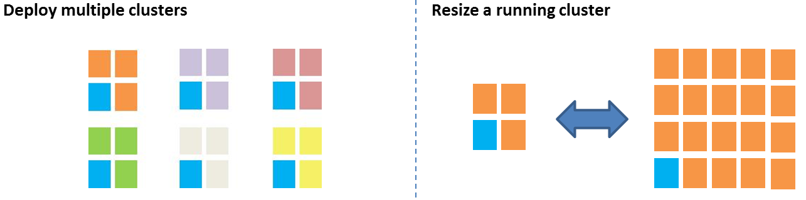
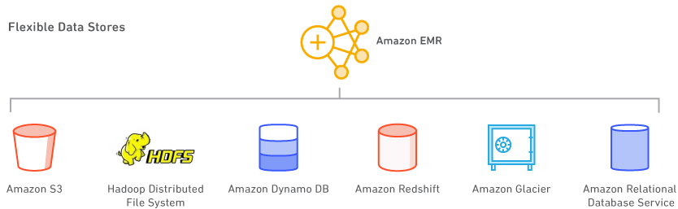
EMR Features
Easy to use
Elastic
Low cost
Use your favorite open-source applications
Flexible data stores
Big Data Tools
Data access control
Credit: https://aws.amazon.com/emr/features/?nc=sn&loc=2&dn=1
Notes:
Reference for contents : https://aws.amazon.com/emr/features/?nc=sn&loc=2&dn=1

Slide 10
EMR Use cases
Perform big data analytics
Build scalable data pipelines
Process real-time data streams
Accelerate data science and ML adoption
Extract, transform, load (ETL)
Clickstream analysis
Genomics
Notes:
Reference for contents :
https://aws.amazon.com/emr/
https://www.amazonaws.cn/en/elasticmapreduce/
More explanation:
Use statistical algorithms and predictive models to perform large-scale data processing and what-if analysis to find hidden patterns, correlations, market trends, and customer preferences.
Data from a variety of sources is extracted, processed at scale, and made available to applications and consumers.
Create long-running, highly available, and fault-tolerant streaming data pipelines by analyzing events from streaming data sources in real time.
Use open-source machine learning frameworks like Apache Spark MLlib, TensorFlow, and Apache MXNet to analyze data. For large-scale model training, analysis, and reporting, connect to Amazon SageMaker.
To segment consumers, identify user preferences, and offer more effective ads, use Apache Spark and Apache Hive to analyze clickstream data from Amazon S3.
EMR can be used to swiftly and efficiently process enormous amounts of genomic data and other large scientific data sets. Amazon Web Services offers free access to genomic data to researchers.

Slide 11
Using Hue with EMR
Hue (Hadoop User Experience) is a web-based graphical user interface for Amazon EMR and Apache Hadoop that is open-source.
Hue is a flexible interface that brings together numerous different Hadoop ecosystem projects. Customizations particular to Hue have also been added to Amazon EMR.
Hue acts as a front-end for apps running on your cluster, allowing you to communicate with them using a more familiar or user-friendly interface.
Hue is already installed when Amazon EMR console is used to launch the cluster. When launching a cluster in the Amazon EMR console, user can select not to install Hue by choosing Advanced options, or by specifically specifying the —applications option and excluding Hue when using create-cluster via the AWS CLI.
Notes:
Reference for contents :
https://docs.aws.amazon.com/emr/latest/ReleaseGuide/emr-hue.html
More explanation:
The Hive and Pig editors, for example, eliminate the requirement to log in to the cluster in order to run scripts interactively using each application's shell. Following the activation of a cluster, user may only communicate with applications using Hue or a comparable interface.

Slide 12
Supported features of Hue on Amazon EMR
Amazon S3 and Hadoop File System (HDFS) Browser
Hive - Run interactive queries on your data. This is also a useful way to prototype programmatic or batched querying.
Pig - Run scripts on your data or issue interactive commands.
Oozie - Create and monitor Oozie workflows.
Metastore Manager - View and manipulate the contents of the Hive metastore (import/create, drop, and so on).
Job browser - See the status of your submitted Hadoop jobs.
AWS Samples - There are several "ready-to-run" examples that process sample data from various AWS services using applications in Hue.
Notes:
Reference for contents :
https://docs.aws.amazon.com/emr/latest/ReleaseGuide/emr-hue-supported-features.html
More explanation:
User management—Manage Hue user accounts and integrate LDAP users with Hue.
Livy Server is supported only in Amazon EMR version 5.9.0 and later.
To use the Hue Notebook for Spark, you must install Hue with Livy and Spark.
The Hue Dashboard is not supported.
PostgreSQL is not supported.

Slide 13
Hive on EMR
Hive is a Hadoop-based open-source data warehouse and analytics software. Hive scripts are written in Hive QL (query language), a SQL-like language that abstracts programming models and supports common data warehouse operations.
Hive allows you to avoid the difficulties of developing Tez jobs in a lower-level computer language, such as Java, that are based on directed acyclic graphs (DAGs) or MapReduce routines.
When using Hive to query, read, and publish data stored in Amazon S3, Amazon EMR provides capabilities to help maximize speed.
By "pushing down" processing to Amazon S3, S3 Select can increase query performance for CSV and JSON data in some applications.
When uploading files to Amazon S3 using EMRFS, the EMRFS S3 optimized committer is an alternative to the OutputCommitter class that removes list and rename operations to increase efficiency.
Notes:
Reference for contents :
https://docs.aws.amazon.com/emr/latest/ReleaseGuide/emr-hive.html
https://docs.aws.amazon.com/emr/latest/ReleaseGuide/emr-hive-s3-performance.html

Slide 14
HBase on EMR
HBase is a non-relational, distributed database that was created as part of the Hadoop project by the Apache Software Foundation. Additional methods for integrating with Amazon S3 for data persistence and disaster recovery are available through Amazon EMR.
HBase provides non-relational database capabilities for the Hadoop ecosystem by running on top of Hadoop Distributed File System (HDFS). Amazon EMR release version 4.6.0 and later includes HBase.
When building an HBase cluster with HBase on Amazon EMR, users can also back up your HBase data straight to Amazon Simple Storage Service (Amazon S3) and recover from a previously made backup.
Notes:
Reference for contents :
https://docs.aws.amazon.com/emr/latest/ReleaseGuide/emr-hbase.html

Slide 15
HBase on EMR
HBase on Amazon S3 – Users can use HBase on Amazon S3 to save a cluster's HBase root directory and information directly to Amazon S3 with Amazon EMR version 5.2.0 and later. After that, users can create a new cluster and point it to Amazon S3's root directory. Except for a read-replica cluster, the HBase location in Amazon S3 can only be used by one cluster at a time.
HBase read-replicas – Read-replica clusters are supported by Amazon EMR version 5.7.0 and later with HBase on Amazon S3. For read-only activities, a read-replica cluster provides read-only access to a primary cluster's store files and metadata.
HBase Snapshots – As an alternative to HBase on Amazon S3, you can create snapshots of your HBase data directly to Amazon S3 and then recover data using the snapshots with EMR version 4.0 and later.
Notes:
Reference for contents :
https://docs.aws.amazon.com/emr/latest/ReleaseGuide/emr-hbase.html

Slide 16
Presto on EMR
Presto is a high-performance SQL query engine for interactive analytic queries on massive datasets from numerous sources.
Presto was built from the bottom up for interactive analytics, and it can scale to the size of Facebook while approaching the speed of commercial data warehouses.
Amazon EMR release versions 5.0.0 and later include Presto.
In December 2020, PrestoSQL was rebranded Trino. Trino is the name given to Amazon EMR versions 6.4.0 and later, while PrestoSQL is the name given to prior release versions.
PrestoDB and Trino both use the same command-line executable, presto-cli, in Amazon EMR.
Notes:
Reference for contents :
https://docs.aws.amazon.com/emr/latest/ReleaseGuide/emr-presto.html
https://prestodb.io/

Slide 17
Presto on EMR
We can use the PrestoS3FileSystem instead of the EMRFS default. Set hive.s3-file-system-type to PRESTO using the presto-connector-hive configuration classification, as illustrated in the following example.
[
{
"Classification": "presto-connector-hive",
"Properties": {
"hive.s3-file-system-type": "PRESTO"
}
}
]
Notes:
Reference for contents :
https://docs.aws.amazon.com/emr/latest/ReleaseGuide/emr-presto-considerations.html
More explanation:
PrestoDB may use EMRFS, which is the default option, with Amazon EMR release version 5.12.0 and later. In Amazon EMR release versions 6.1.0 and beyond, EMRFS is also the default file system of Trino (PrestoSQL).

Slide 18
Spark on EMR
Apache Spark is a distributed processing framework and programming model for Amazon EMR clusters that enables machine learning, stream processing, and graph analytics. It is an open-source, distributed processing engine that is often used for big data applications, similar to Apache Hadoop.
Spark includes an improved directed acyclic graph (DAG) execution engine and actively caches data in memory, which can improve performance, particularly for interactive searches and certain algorithms.
Scala, Python, and Java applications are all supported natively by Spark. It also comes with a number of closely integrated libraries for SQL (Spark SQL), machine learning (MLlib), stream processing (Spark streaming), and graph processing (Spark graph) (GraphX).
Notes:
Reference for contents :
https://docs.aws.amazon.com/emr/latest/ReleaseGuide/emr-spark.html

Slide 19
Spark on EMR
Spark may be installed alongside other Hadoop applications on an Amazon EMR cluster, and it can also use the EMR file system (EMRFS) to directly access data in Amazon S3
Hive is also integrated with Spark, allowing you to run Hive scripts with Spark using a HiveContext object. The sqlContext variable in the spark-shell represents a Hive context.
Here is how we can create a cluster with Spark in EMR:
Go to https://console.aws.amazon.com/elasticmapreduce/ to access the Amazon EMR console.
To use Quick Options, select Create cluster.
Enter Cluster name.
Notes:
Reference for contents :
https://docs.aws.amazon.com/emr/latest/ReleaseGuide/emr-spark-launch.html

Slide 20
Spark on EMR
Select a Release option for Software Configuration.
Select the Spark application bundle under Applications.
Select the rest of the options as needed, and then click Create cluster.
To launch a cluster with Spark installed using the AWS CLI
aws emr create-cluster --name "Spark cluster" --release-label emr-5.35.0 --applications Name=Spark \
--ec2-attributes KeyName=myKey --instance-type m5.xlarge --instance-count 3 --use-default-roles
Notes:
Reference for contents :
https://docs.aws.amazon.com/emr/latest/ReleaseGuide/emr-spark-launch.html

Slide 21
EMR File Storage and Compression
Amazon EMR uses a variety of file systems when processing cluster steps. The two main file systems utilised by Amazon EMR are HDFS and EMRFS
The prefix of the URI used to access the data specifies the file system to utilise. s3:/DOC-EXAMPLE-BUCKET1/path, for example, refers to an Amazon S3 bucket that uses EMRFS.
Apart from HDFS and EMRFS, Amazon EMR also uses the local file system and Amazon S3 block file system to store data.
The instructions that follow demonstrate how to refer to a variety of file systems using URI.
Accessing a local HDFS
Notes:
Reference for contents :
https://docs.aws.amazon.com/emr/latest/ManagementGuide/emr-plan-file-systems.html

Slide 22
EMR File Storage and Compression
hdfs:///path-to-data
/path-to-data
Accessing remote HDFS
hdfs://master-ip-address/path-to-data
master-ip-address/path-to-data
Accessing Amazon S3 and Amazon S3 block file system
s3://bucket-name/path-to-file-in-bucket
s3bfs://bucket-name/path-to-file-in-bucket
Notes:
Reference for contents :
https://docs.aws.amazon.com/emr/latest/ManagementGuide/emr-plan-file-systems.html

Slide 23
EMR File Storage and Compression
To compress files in Amazon EMR, Hadoop looks at the file extension to see if it's compressed.
Hadoop supports the compression formats gzip, bzip2, and LZO.
The users don't have to do anything extra to extract files using these methods of compression; Hadoop takes care of it.
The hadoop-lzo package, which may be found at https://github.com/kevinweil/hadoop-lzo, can be used to index LZO files.
Notes:
Reference for contents :
https://docs.aws.amazon.com/emr/latest/ManagementGuide/HowtoProcessGzippedFiles.html

Slide 24
Lambda in AWS Big Data Ecosystem
AWS Lambda in Big Dara Ecosystem allows you to run code without having to provision or manage servers.
Users can run code for nearly any form of application or backend service with Lambda, and they don't have to worry about administration. Simply upload the code, and Lambda will handle everything necessary to run and grow it with high availability.
There are no fees for idle time in AWS Lambda, users just have to pay for the compute time they use.
Users can also set up your code to be triggered automatically by other AWS services, or they can call it directly from any web or mobile app.
Notes:
Reference for contents :
https://docs.aws.amazon.com/whitepapers/latest/big-data-analytics-options/aws-lambda.html

Slide 25
Lambda in AWS Big Data Ecosystem
AWS Lambda allows you to run code in reaction to events such as data updates, system state adjustments, or user activities. AWS services including Amazon S3, DynamoDB, Amazon Kinesis Data Streams, Amazon Simple Notification Service (Amazon SNS), and Amazon CloudWatch may directly trigger Lambda, allowing you to create a variety of real-time data processing systems:
Some of the different scenarios wherein you can trigger AWS Lambda are real-time file processing, real-time stream processing, extract, transform and load (ETL), Replace Cron and Process AWS events.
When it comes to its performance, Customers can regulate the performance of their serverless apps at any scale with the Lambda provided concurrency capability.
Notes:
Reference for contents :
https://docs.aws.amazon.com/whitepapers/latest/big-data-analytics-options/aws-lambda.html

Slide 26
Lambda in AWS Big Data Ecosystem
Functions are often ready to call within seconds of uploading your code to Lambda for the first time. Lambda is built to handle events in milliseconds.
In terms of durability and availability, AWS Lambda is meant to ensure high availability for both the service and the Lambda functions it manages through replication and redundancy.
When using Lambda, there is no limit to how many Lambda functions you can execute, thereby increasing the scalability.
Lambda functions can be handled in a number of different ways. The dashboard in the Lambda console allows to easily list, delete, update, and monitor the Lambda functions.
Notes:
Reference for contents :
https://docs.aws.amazon.com/whitepapers/latest/big-data-analytics-options/aws-lambda.html

Slide 27
HCatalog
HCatalog is a tool that lets you use Pig, Spark SQL, and/or custom MapReduce apps to access Hive metastore tables.
Users can build tables and perform other activities using HCatalog's REST interface and command line client. Then, using HCatalog libraries, they can also develop apps to access the tables.
HCatalog on Amazon EMR release version 5.8.0 and later supports AWS Glue Data Catalog as the Hive metastore.
Notes:
Reference for contents :
https://docs.aws.amazon.com/emr/latest/ReleaseGuide/emr-hcatalog.html

Slide 28
HCatalog
Steps to create a cluster with Hcatalog in AWS
Go to https://console.aws.amazon.com/elasticmapreduce/ to access the Amazon EMR console.
To use Quick Create, select Create cluster.
Choose Amazon Release Version emr-4.4.0 or later in the Software Configuration field.
Select All Applications or HCatalog in the Select Applications section.
Select the rest of the options as needed, and then click Create cluster.
Notes:
Reference for contents :
https://docs.aws.amazon.com/emr/latest/ReleaseGuide/emr-hcatalog-create-cluster.html

Slide 29
Glue
AWS Glue is a fully managed ETL (extract, transform, and load) service that enables categorising, cleaning, enriching, and reliably moving data across various data storage and data streams simple and cost-effective.
AWS Glue is made up of three parts: the AWS Glue Data Catalog, an ETL engine that creates Python or Scala code automatically, and a customizable scheduler that manages dependency resolution, task monitoring, and retries.
There's no infrastructure to set up or manage with AWS Glue because it's serverless.
AWS Glue was created with semi-structured data in mind. It adds a dynamic frame component that you may utilise in your ETL processes.
Notes:
Reference for contents :
https://docs.aws.amazon.com/emr/latest/ReleaseGuide/emr-hbase.html

Slide 30
Glue
The AWS Glue console may be used to find data, alter it, and make it searchable and queryable.
To interact with AWS Glue services, users can use the AWS Glue API operations. Using a familiar development environment, they can edit, debug, and test the Python or Scala Apache Spark ETL code.
When creating a data warehouse or data lake, AWS Glue makes numerous jobs easier:
ETL scripts are generated to transform, flatten, and enrich your data as it moves from source to target.
Detects changes in your schema and adapts to your preferences.
Scheduled crawler scripts are used to populate the AWS Glue Data Catalog with table definitions.
Notes:
Reference for contents :
https://docs.aws.amazon.com/glue/latest/dg/what-is-glue.html

Slide 31
Glue
Your ETL jobs are triggered depending on a schedule or event. You may set up jobs to transport your data into your data warehouse or data lake automatically. Triggers can be used to construct a job-to-job dependence flow.
Gathers runtime metrics to keep track of your data warehouse or data lake's activity.
Errors and retries are handled automatically.
Scales resources to run your jobs as needed.
Notes:
Reference for contents :
https://docs.aws.amazon.com/glue/latest/dg/what-is-glue.html

